Slide 1
Presentation on
Ride Rent
Developed by:
210943120092-Rhushikesh Shrike
210943120047-Kunal Bagul
210943120118-Swapnil Zanje
210943120025-Chetan Bhalkare

Slide 2
Introduction :
Vehicle management system is a web based system for a company that rents a vehicle to the customer who is interested in renting a car or taking on rent.
To develop a web based system that will help manage the business of renting the vehicles of owner(user).
This project have three kinds of module Customer, Owner and Admin .

Slide 3
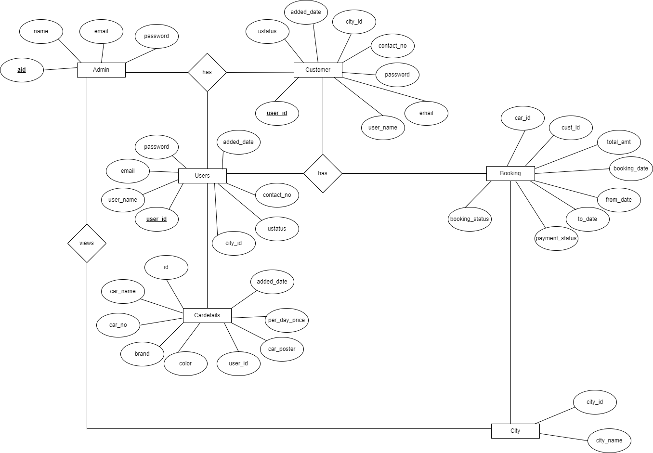
ER Diagram:

Slide 4
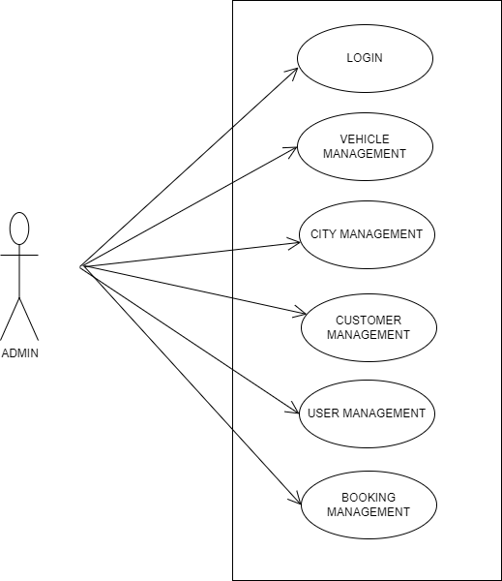
Use case Diagram of Admin :

Slide 5
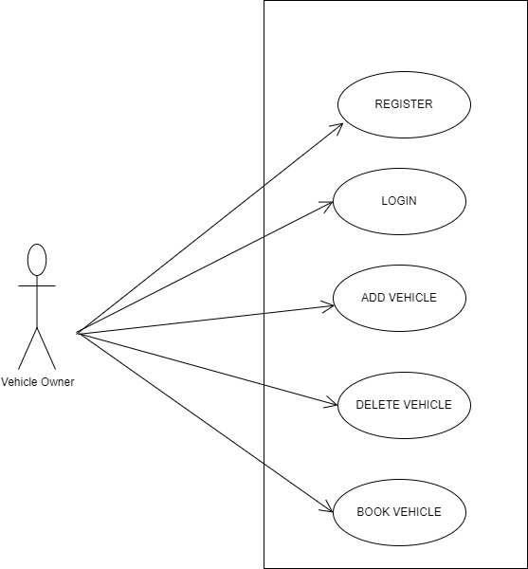
Use Case Diagram of Owner :

Slide 6
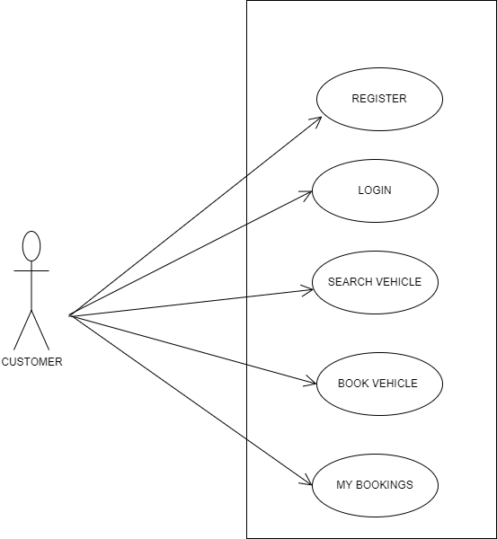
Use Case Diagram of Customer :

Slide 7
Modules And Description :
Ride Rent consists of three modules described as below:
Customer Module
Vehicle Owner Module
Admin Module
Customer Module:
• Customer can login or register.
• Customer can search for a Vehicle.
• Customer can book the particular vehicle.
• Email received for when booking vehicle.

Slide 8
Owner Module :
Owner can login or register
Owner can add a vehicle for rent
Owner can delete a vehicle from system
Owner also book an another vehicle

Slide 9
Admin Module:
Admin can login.
Admin can approve Booking.
Admin can manage your booking.
Admin can manage vehicle list.
Admin can manage city management.
Admin can manage user management.

Slide 10
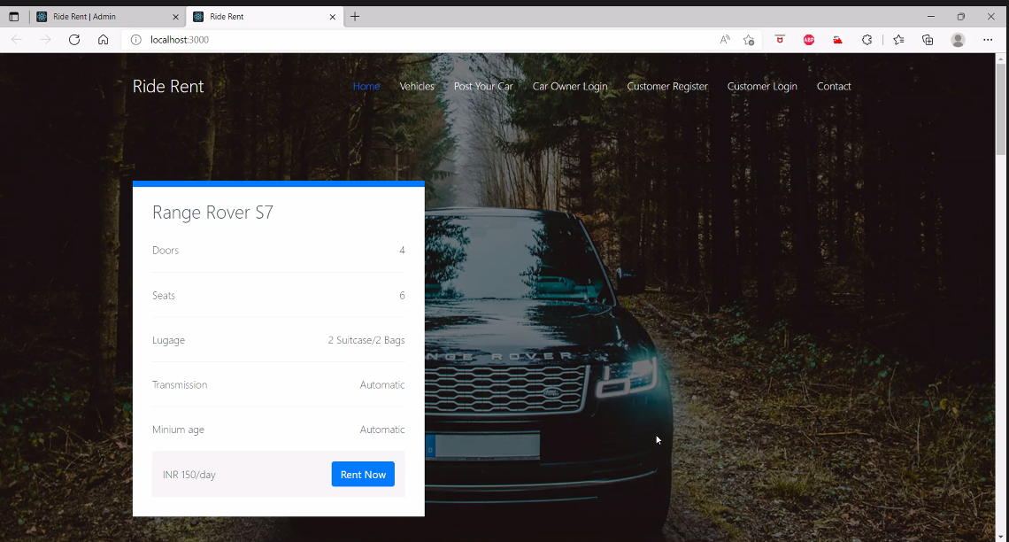
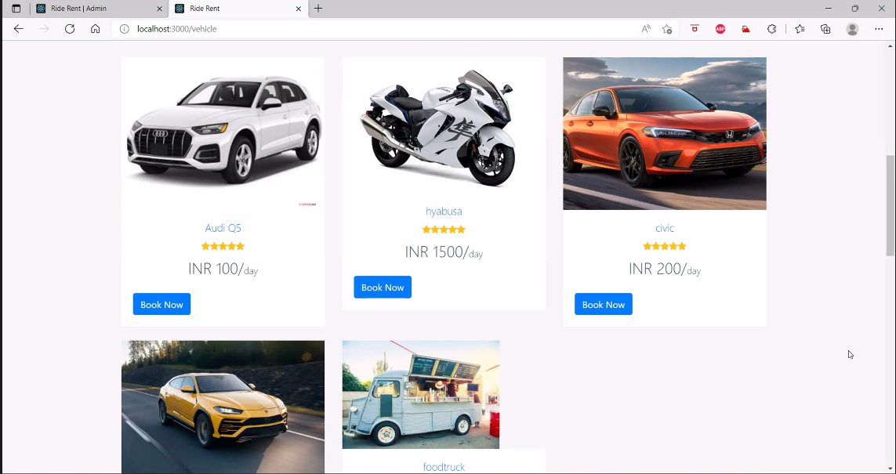

Slide 11
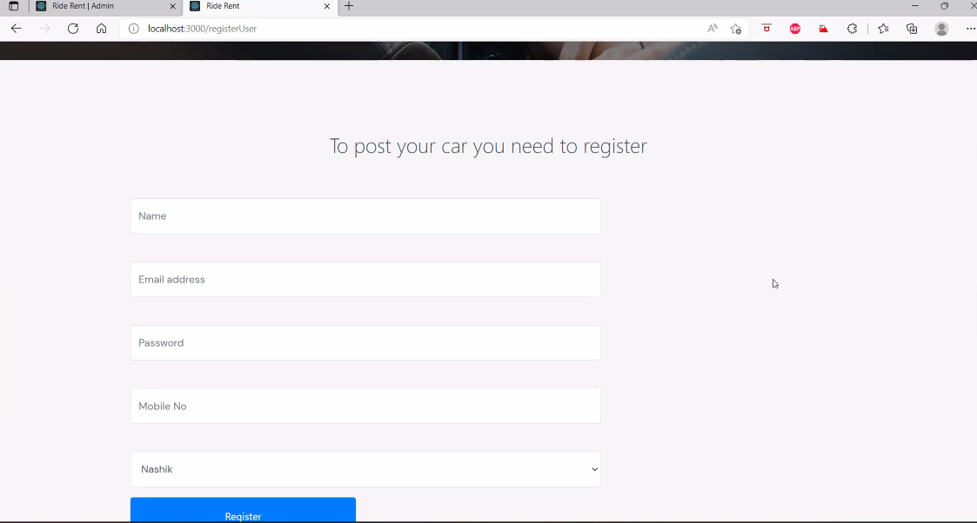
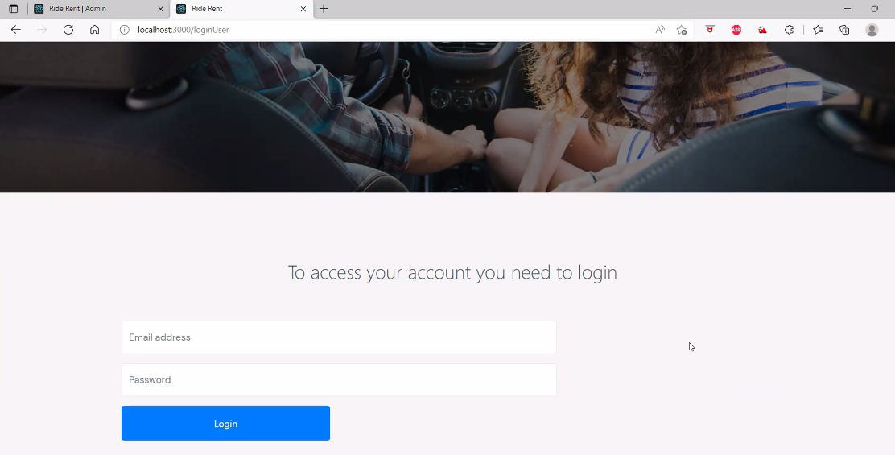
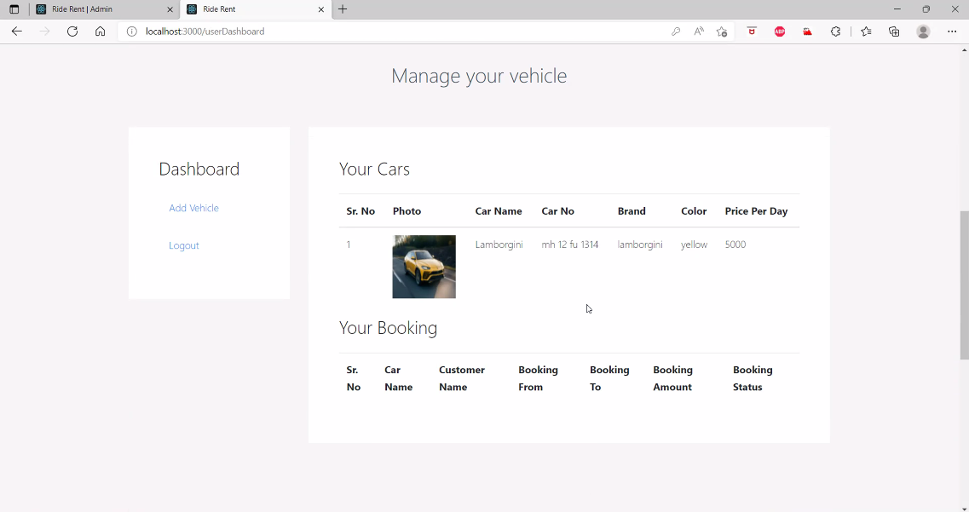

Slide 12
Future Enhancement :
Chat Application.
Adding more number of cities.
GPS – Car Detection.
Pickup & Drop Modes.

Slide 13
Thank You

